Slide 1

Development of Software for Parameter Estimation and its Application on Wind Power Plant Equivalent Model
Gabriel José Negrelli Gomes
Advisor: Prof. Dr. Elmer Pablo Tito Cari
São Carlos School of Engineering - EESC
University of São Paulo - USP

Slide 2
Introduction
Increase in renewables participation
Mainly solar and wind energy
Clean alternative to fossil fuels
Rely on weather condition

Slide 3
Introduction
Worldwide increase leaded by:
United States
China
European Union
2010 bill
Reduce greenhouse emissions by 20% (1990 levels)
20% share of renewables by 2020

Slide 4
Introduction
Brazilian Panorama:
2002 bill
Creates PROINFA
Increase wind, solar, small hydro and biomass share
Renewables supplying 10% of energy by 2024

Slide 5
Wind Energy
Wind energy benefited from these policies
European Union:
417 TWh in 2019
15% of electricity demand (1% higher than 2018)
192 GW of installed capacity (UK included)

Slide 6
Wind Energy
Source: WindEurope, 2020

Slide 7
Wind Energy
Brazil
48.5 TWh in 2018 (Itaipu: 96.5 TWh)
8.1% of electricity demand (14.4% higher than 2017)
15.5 GW of installed capacity

Slide 8
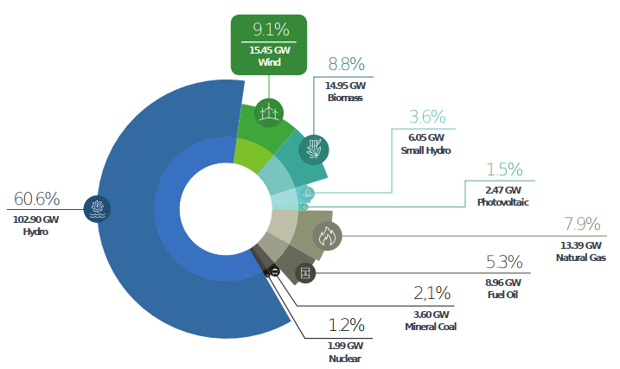
Wind Energy
Source: ABEEolica, 2020

Slide 9
Wind Energy
Brazil
Energy yield yet to be explored
Potential to generate 272 TWh
144 TWh in the Northeast Region
Complimentary regimes of wind and water (São Francisco River)

Slide 10
Wind Energy
Source: ANEEL, 2005

Slide 11
Wind Energy
Growth expectations for this source
Disadvantages:
Stochastic source
Not evenly distributed
Generators with low inertia
Affects system stability

Slide 12
Wind Energy
Study of effects of these plants on stability
Need of mathematical models
Multiple generators
Equivalent model
Source: Adapted from (MULJADI; ELLIS, 2008)

Slide 13
Research Goals
Development of software for parameter estimation
Package with estimation framework
Graphical user interface (GUI)
Application on wind power plant equivalent model

Slide 14
Wind Turbine Generators

Slide 15
Wind Turbine Generators
Huge variety of generators
Task force to develop generic models
Four types of wind turbine generators
Representation of wind power plants by one machine

Slide 16
Wind Turbine Generators
Type-1 Wind Turbine (SCIG):
Squirrel-Cage Induction Generator
Operates at constant speed
Reactive compensation

Slide 17
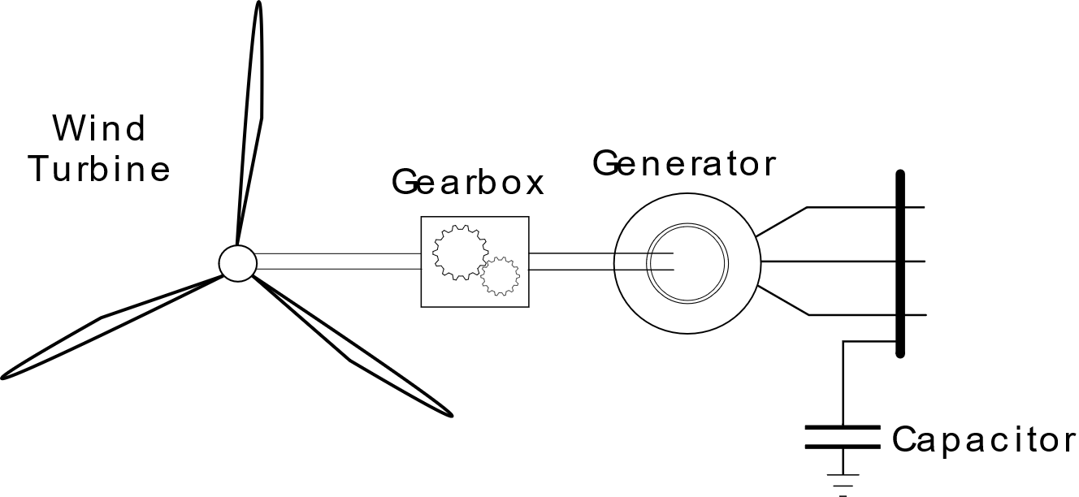
Wind Turbine Generators
Type-1 Wind Turbine (SCIG):

Slide 18
Wind Turbine Generators
Type-2 Wind Turbine (WRIG):
Wound Rotor Induction Generator
Rotor resistance variation
Reactive compensation

Slide 19
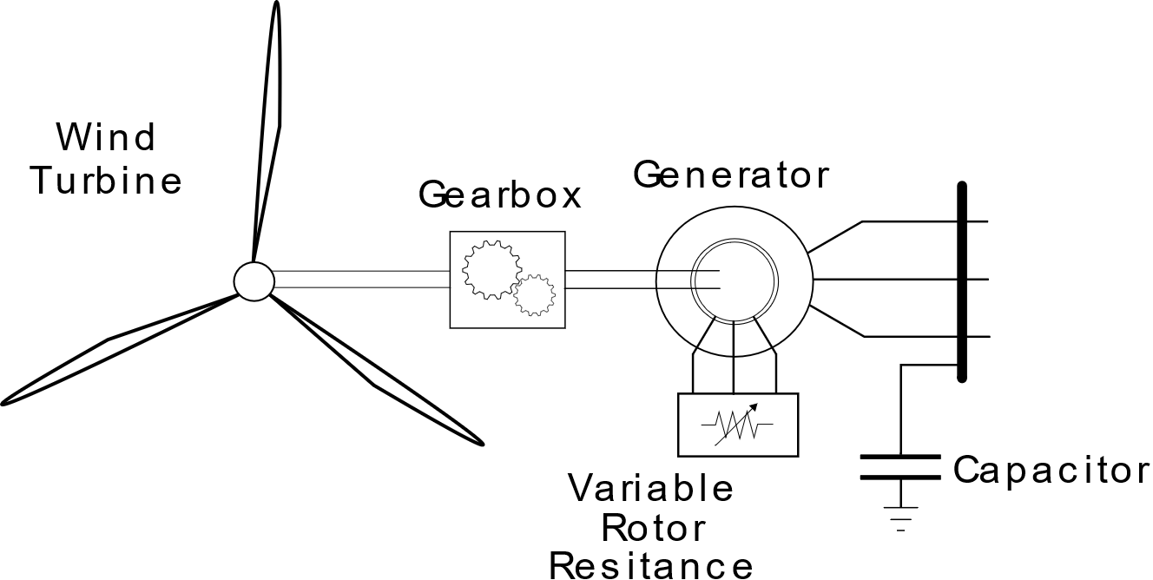
Wind Turbine Generators
Type-2 Wind Turbine (WRIG):

Slide 20
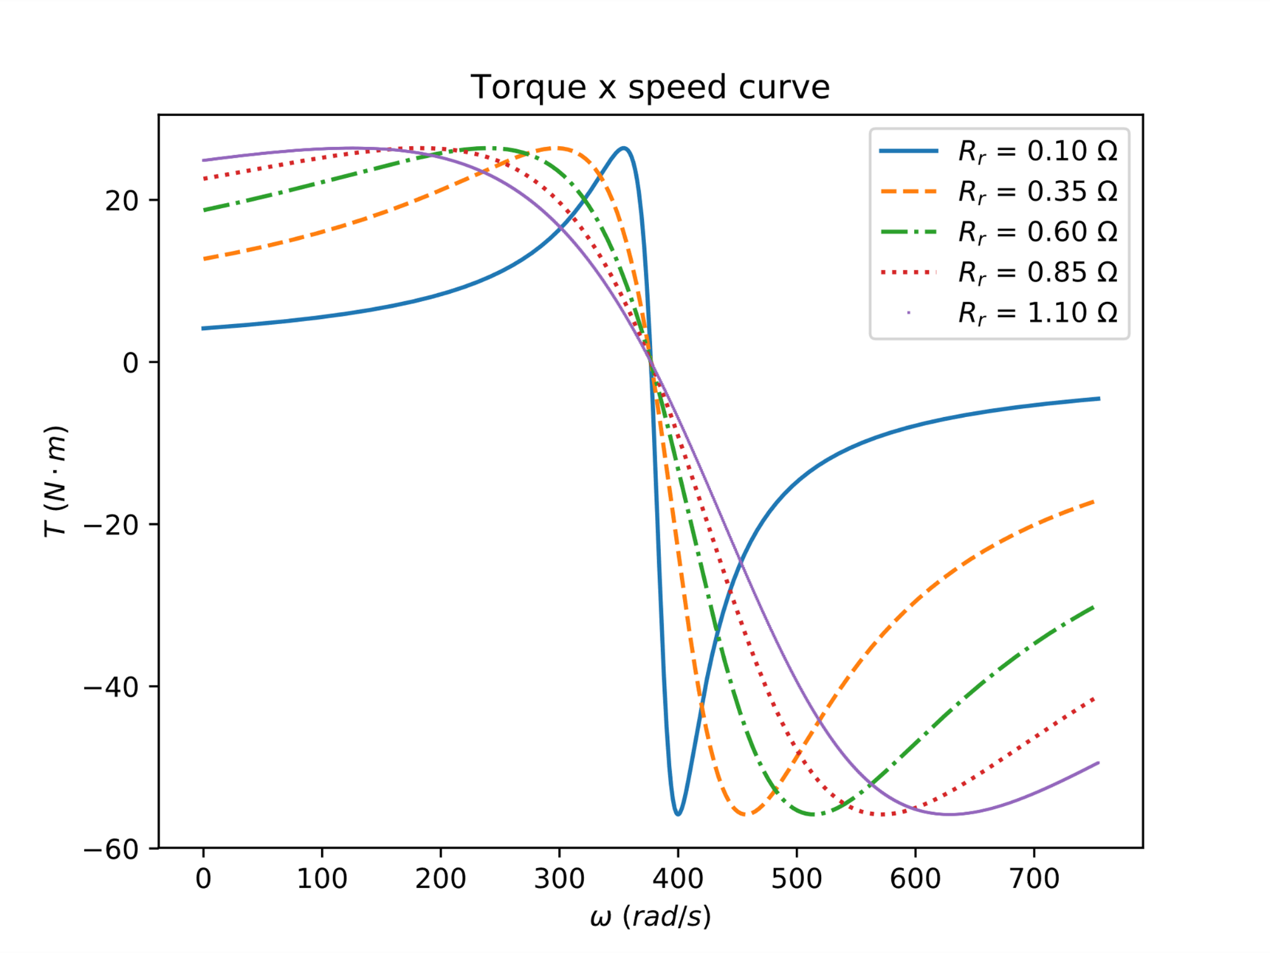
Wind Turbine Generators
Type-2 Wind Turbine (WRIG):
Alter torque-speed curve

Slide 21
Wind Turbine Generators
Type-3 Wind Turbine (DFIG):
Doubly Fed Induction Generator
Wound Rotor Induction Generator + frequency converter
Operates at ± 30% of rated speed
Reactive injection control

Slide 22
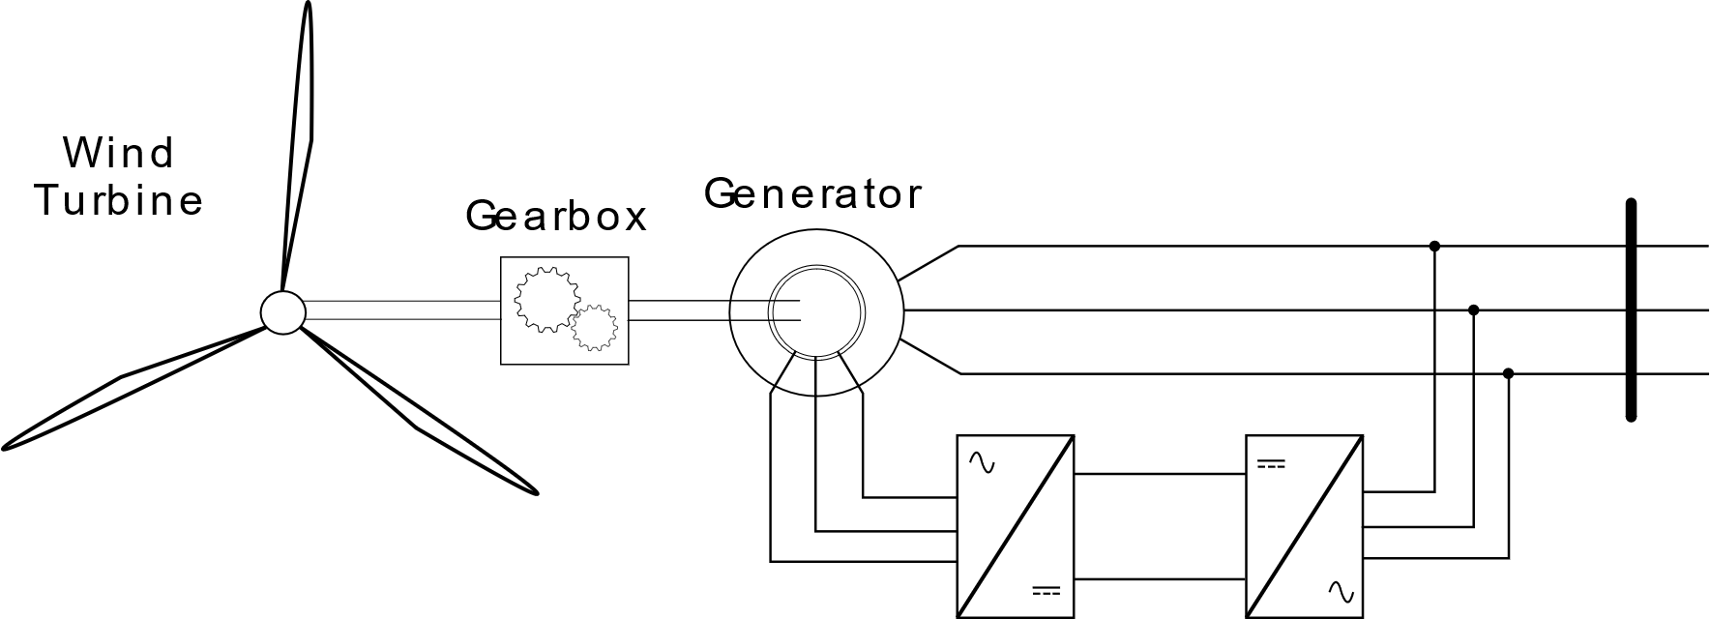
Wind Turbine Generators
Type-3 Wind Turbine (DFIG):

Slide 23
Wind Turbine Generators
Type-4 Wind Turbine:
Induction/Synchronous Generator
Grid connection through converter
Wide speed range
Reactive injection control

Slide 24
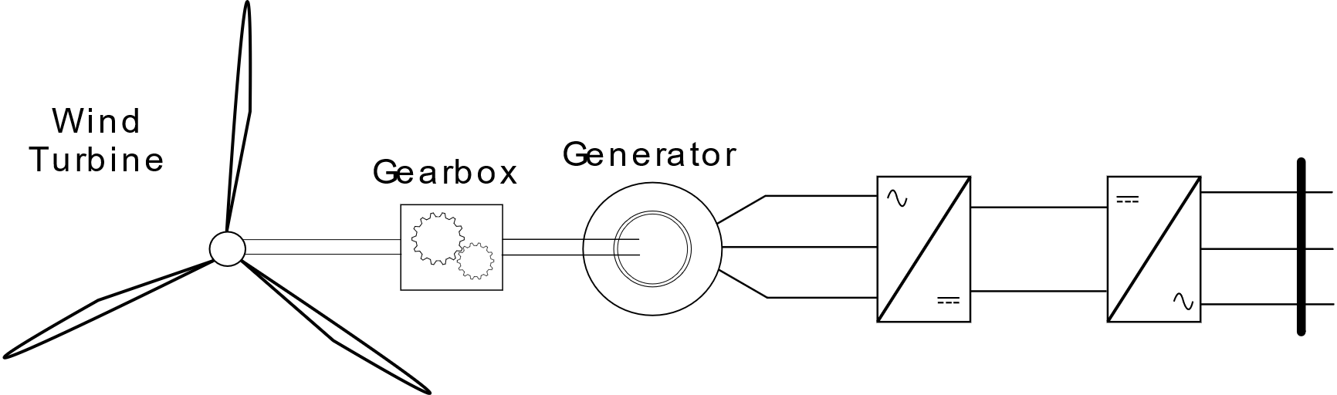
Wind Turbine Generators
Type-4 Wind Turbine:

Slide 25
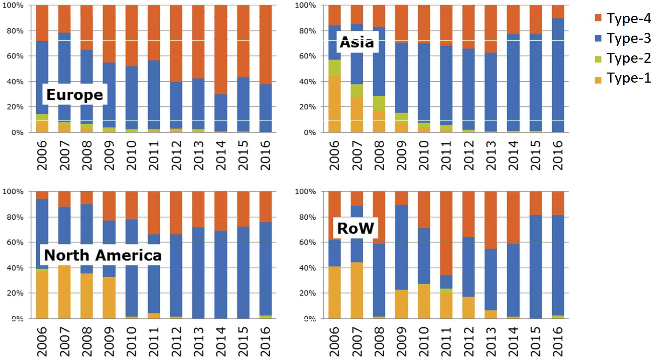
Wind Turbine Generators
Source: JRC, 2017

Slide 26
Wind Power Plant Model

Slide 27
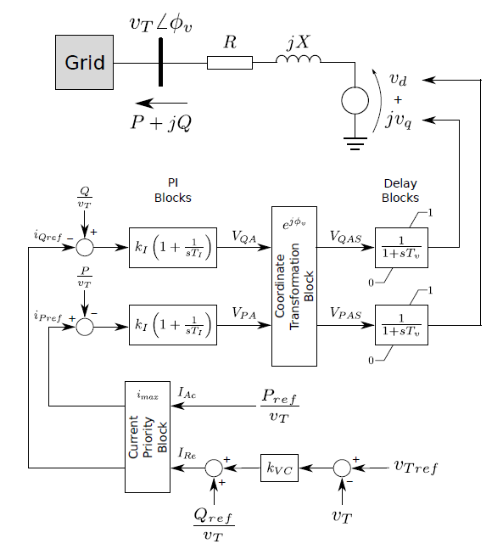
Wind Power Plant Model
Source: Adapted from (ERLICH et al., 2012)

Slide 28
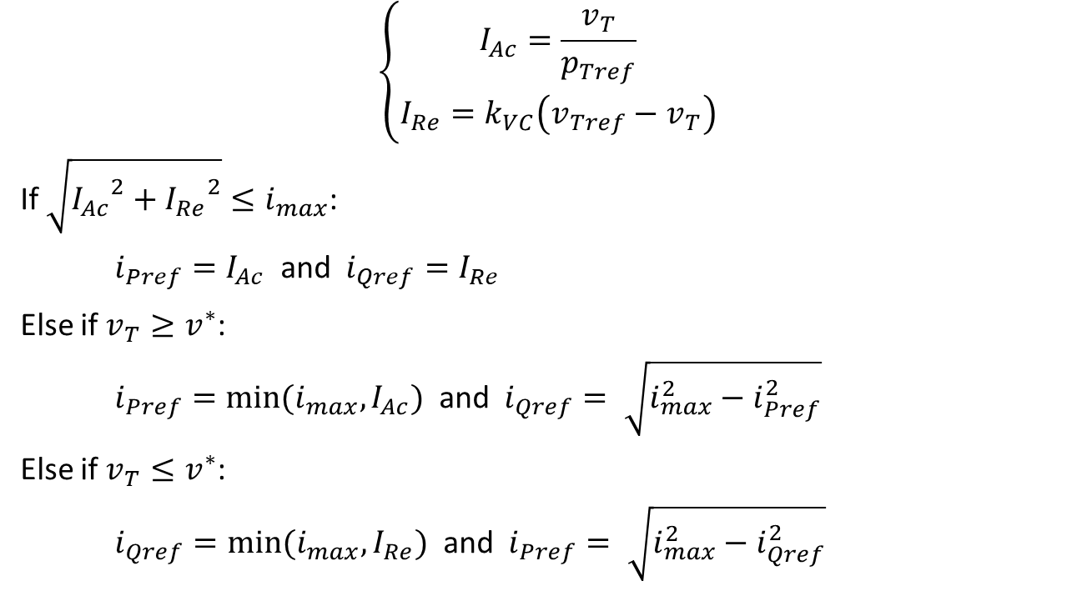
Wind Power Plant Model
$$\left\{\begin{aligned}I_{Ac}=\frac{v_{T}}{p_{Tref}} \\ I_{Re}=k_{VC}\left(v_{Tref}−v_{T}\right)\end{aligned}\right.$$
If $\sqrt{{I_{Ac}}^{2}+{I_{Re}}^{2}}≤i_{max}$:
$i_{Pref}=I_{Ac}$ and $i_{Qref}=I_{Re}$
Else if $v_{T}≥v^{∗}$:
$i_{Pref}=min⁡(i_{max}, I_{Ac})$ and $i_{Qref}= \sqrt{i_{max}^{2}−i_{Pref}^{2}}$
Else if $v_{T}≤v^{∗}$:
$i_{Qref}=min⁡(i_{max}, I_{Re})$ and $i_{Pref}= \sqrt{i_{max}^{2}−i_{Qref}^{2}}$

Slide 29
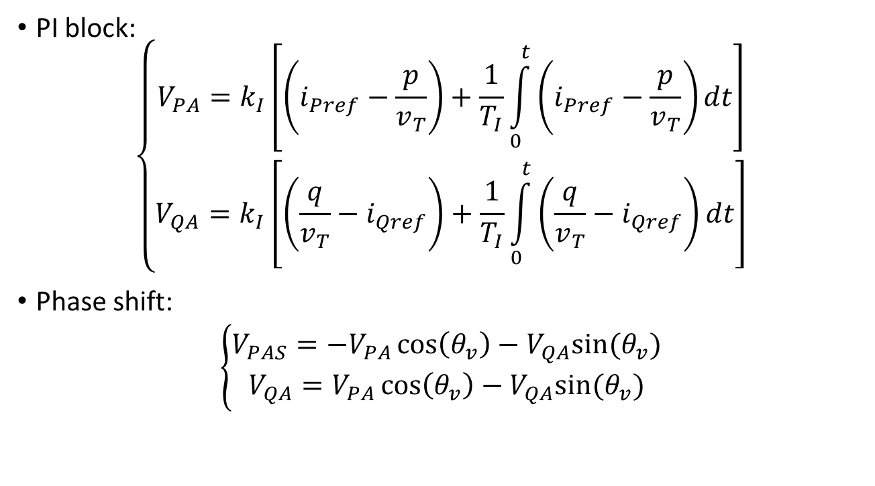
Wind Power Plant Model
PI block:
$$\left\{\begin{aligned}V_{PA}=k_{I}\left[\left(i_{Pref}−\frac{p}{v_{T}}\right)+\frac{1}{T_{I}}\int_{0}^{t}{\left(i_{Pref}−\frac{p}{v_{T}}\right)dt}\right] \\ V_{QA}=k_{I}\left[\left(\frac{q}{v_{T}}−i_{Qref}\right)+\frac{1}{T_{I}}\int_{0}^{t}{\left(\frac{q}{v_{T}}−i_{Qref}\right)dt}\right]\end{aligned}\right.$$
Phase shift:
$$\left\{\begin{aligned}V_{PAS}=−V_{PA}\cos\left(θ_{v}\right)−V_{QA}sin⁡(θ_{v}) \\ V_{QA}=V_{PA}\cos\left(θ_{v}\right)−V_{QA}sin⁡(θ_{v})\end{aligned}\right.$$

Slide 30
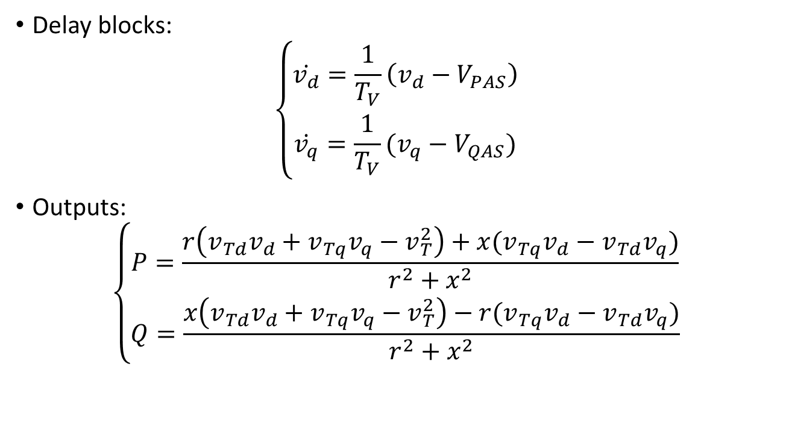
Wind Power Plant Model
Delay blocks:
$$\left\{\begin{aligned}\dot{v_{d}}=\frac{1}{T_{V}}\left(v_{d}−V_{PAS}\right) \\ \dot{v_{q}}=\frac{1}{T_{V}}(v_{q}−V_{QAS})\end{aligned}\right.$$
Outputs:
$$\left\{\begin{aligned}P=\frac{r\left(v_{Td}v_{d}+v_{Tq}v_{q}−v_{T}^{2}\right)+x(v_{Tq}v_{d}−v_{Td}v_{q})}{r^{2}+x^{2}} \\ Q=\frac{x\left(v_{Td}v_{d}+v_{Tq}v_{q}−v_{T}^{2}\right)−r(v_{Tq}v_{d}−v_{Td}v_{q})}{r^{2}+x^{2}}\end{aligned}\right.$$

Slide 31
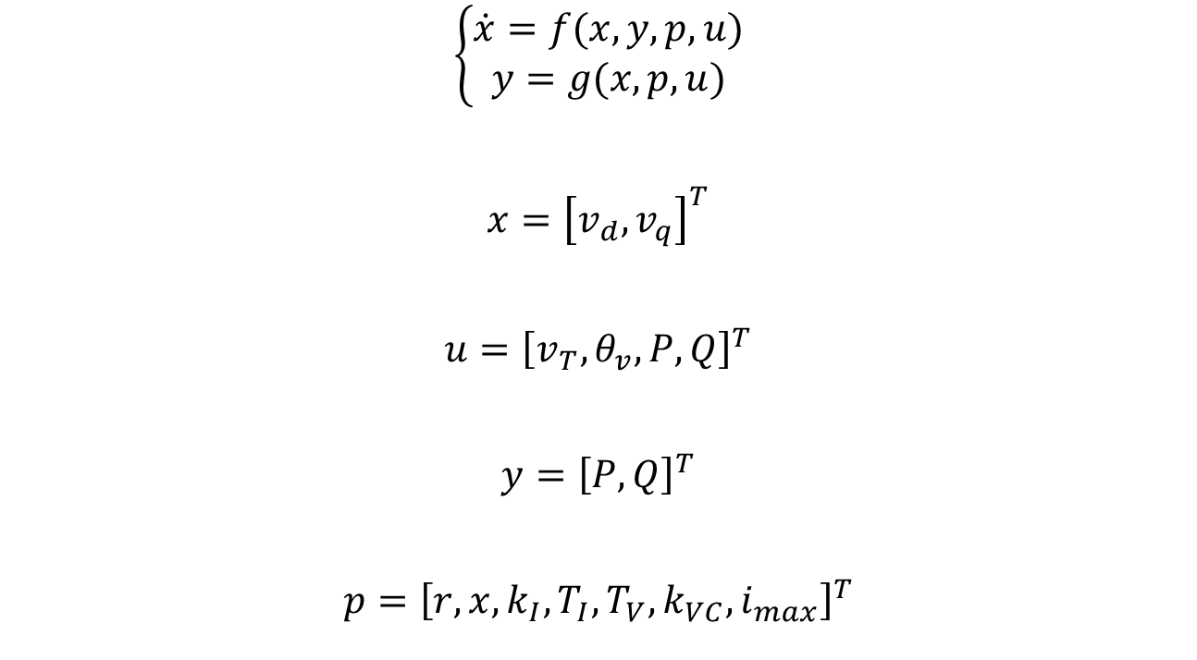
Wind Power Plant Model
$$\left\{\begin{aligned}\dot{x}=f(x,y,p,u) \\ y=g(x,p,u)\end{aligned}\right.$$
$$x={\left[v_{d}, v_{q}\right]}^{T}$$
$$u={\left[v_{T},θ_{v},P,Q\right]}^{T}$$
$$y={\left[P, Q\right]}^{T}$$
$$p={\left[r,x,k_{I},T_{I},T_{V},k_{VC}, i_{max}\right]}^{T}$$

Slide 32
Wind Power Plant Model
Represent Type-3 and Type-4 Generators
Behaviour of wind power plants
Transient studies
Disadvantages:
PMUs required to obtain angle measurement

Slide 33
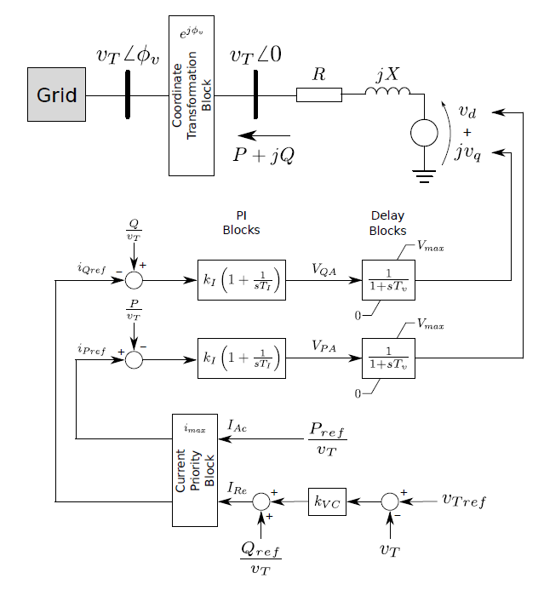
Proposed Wind Power Plant Model

Slide 34
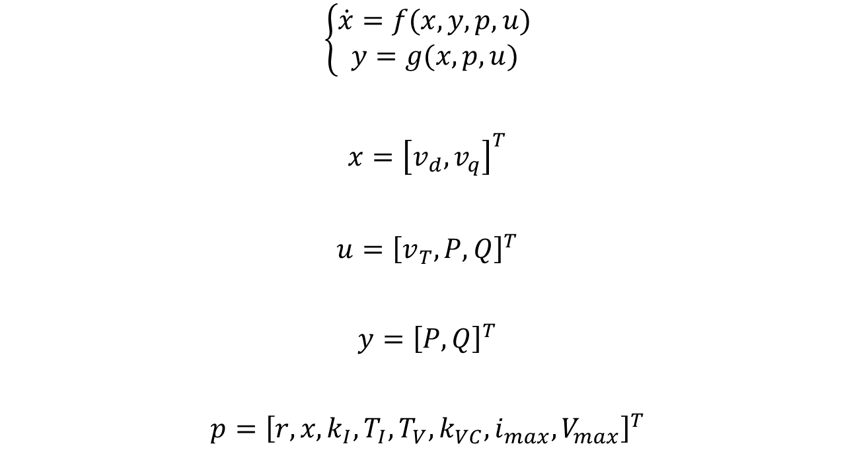
Proposed Wind Power Plant Model
$$\left\{\begin{aligned}\dot{x}=f(x,y,p,u) \\ y=g(x,p,u)\end{aligned}\right.$$
$$x={\left[v_{d}, v_{q}\right]}^{T}$$
$$u={\left[v_{T}, P,Q\right]}^{T}$$
$$y={\left[P, Q\right]}^{T}$$
$$p={\left[r,x,k_{I},T_{I},T_{V},k_{VC},i_{max},V_{max}\right]}^{T}$$

Slide 35
Parameter Estimation Method

Slide 36
Parameter Estimation Method

Slide 37
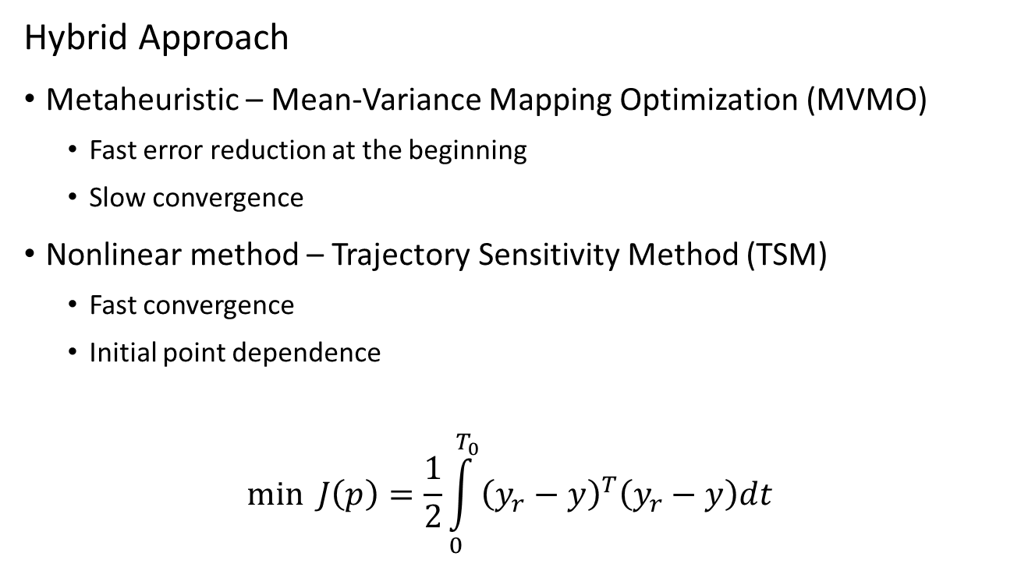
Parameter Estimation Method
Hybrid Approach
Metaheuristic – Mean-Variance Mapping Optimization (MVMO)
Fast error reduction at the beginning
Slow convergence
Nonlinear method – Trajectory Sensitivity Method (TSM)
Fast convergence
Initial point dependence
$$\min{J\left(p\right)=\frac{1}{2}\int_{0}^{T_{0}}{{\left(y_{r}−y\right)}^{T}\left(y_{r}−y\right)dt} }$$

Slide 38
MVMO
Population-based metaheuristic
Offspring considering population statistics
Great results for small populations

Slide 39
MVMO
Setup
Population size
Number of offspring
Number of genes for mutation
Selection method
Normalized search region

Slide 40




MVMO
Best
Worst

Slide 41
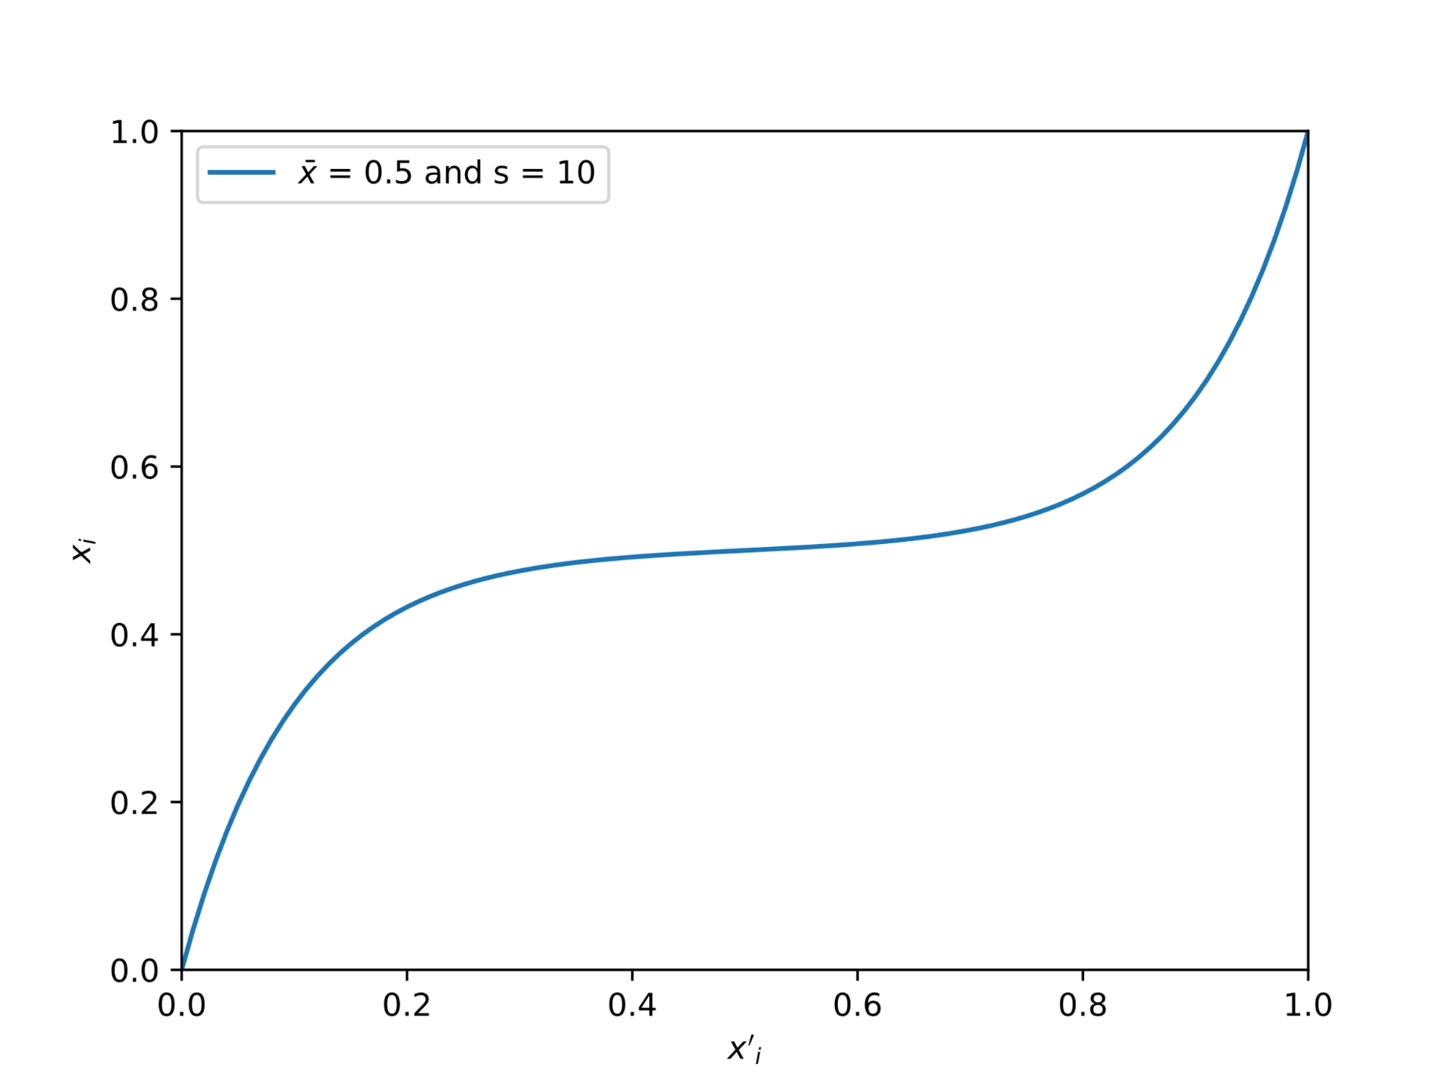
MVMO
Mutation
Mapping function based on mean and variance

Slide 42
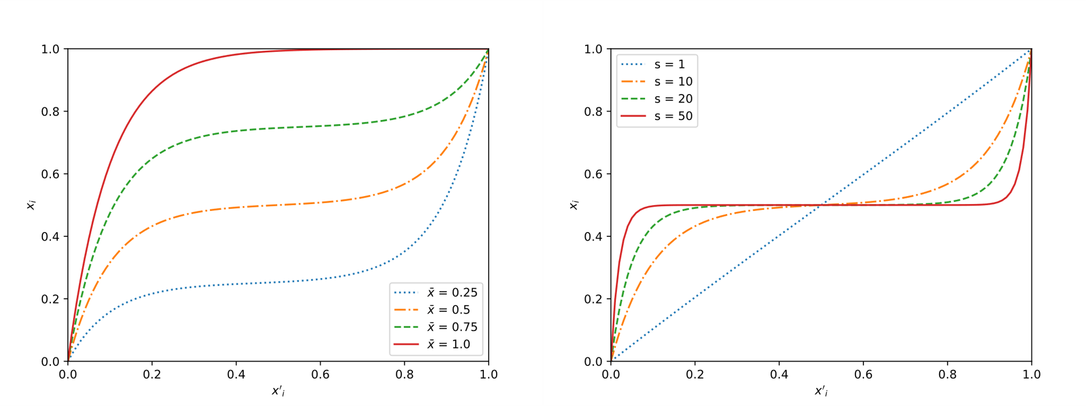
MVMO
Mean and variance effects

Slide 43
TSM
Based on Newton-Raphson
Fast convergence
Initial values dependence

Slide 44
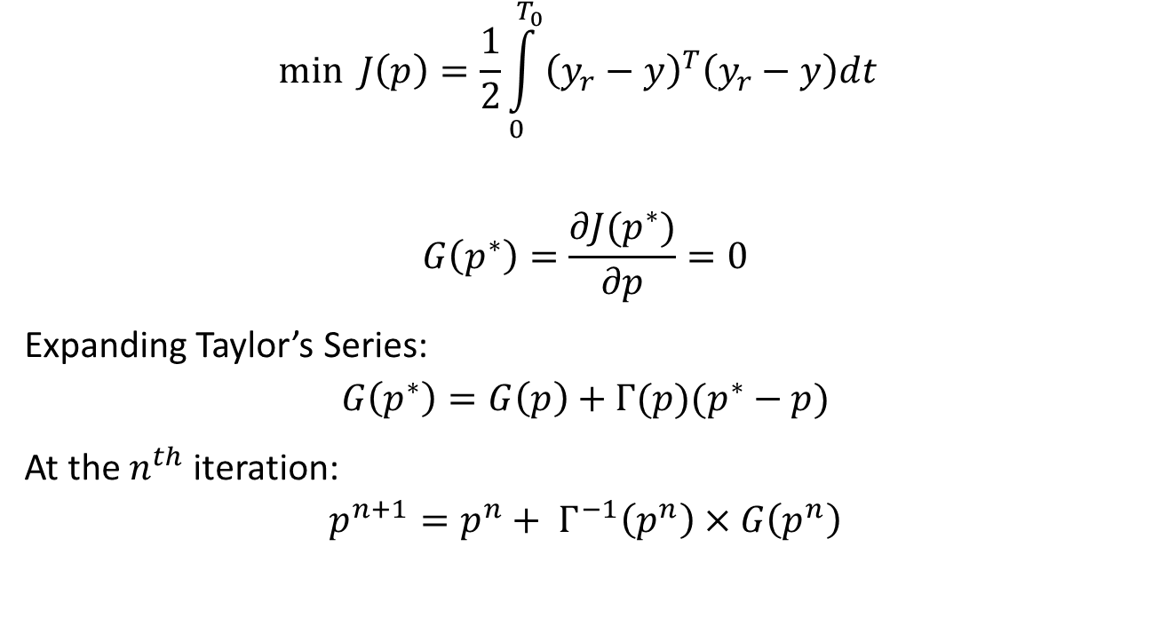
TSM
$$\min{J\left(p\right)=\frac{1}{2}\int_{0}^{T_{0}}{{\left(y_{r}−y\right)}^{T}\left(y_{r}−y\right)dt} }$$
$$G\left(p^{∗}\right)=\frac{∂J(p^{∗})}{∂p}=0$$
Expanding Taylor’s Series:
$$G\left(p^{∗}\right)=G\left(p\right)+Γ(p)(p^{∗}−p)$$
At the $n^{th}$ iteration:
$$p^{n+1}=p^{n}+ Γ^{−1}\left(p^{n}\right)×G\left(p^{n}\right)$$

Slide 45
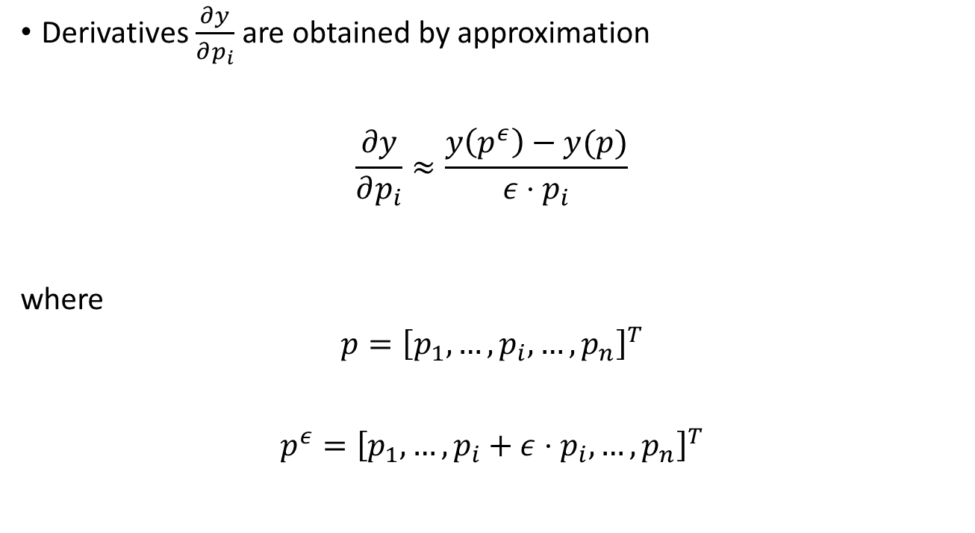
TSM
Derivatives $\frac{∂y}{∂p_{i}}$ are obtained by approximation
$$\frac{∂y}{∂p_{i}}≈\frac{y\left(p^{ε}\right)−y(p)}{ε⋅p_{i}}$$
where
$$p={\left[p_{1},…,p_{i},…,p_{n}\right]}^{T}$$
$$p^{ε}={\left[p_{1},…,p_{i}+ε⋅p_{i},…,p_{n}\right]}^{T}$$

Slide 46
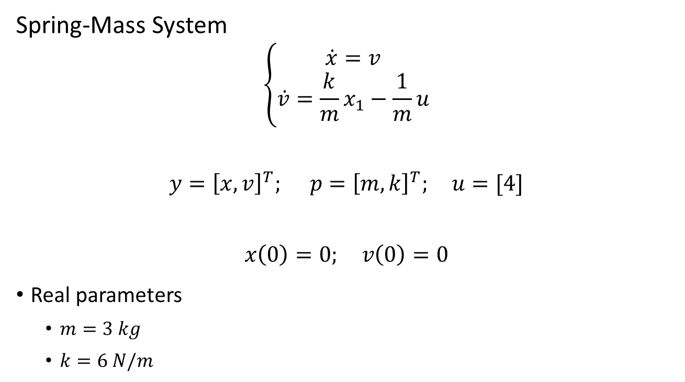
Hybrid Method Application
Spring-Mass System
$$\left\{\begin{aligned}\dot{x}=v \\ \dot{v}=\frac{k}{m}x_{1}−\frac{1}{m}u\end{aligned}\right.$$
$$y={\left[x,v\right]}^{T}; p={\left[m,k\right]}^{T}; u=[4]$$
$$x\left(0\right)=0; v\left(0\right)=0$$
Real parameters
$m=3 kg$
$k=6 N/m$

Slide 47
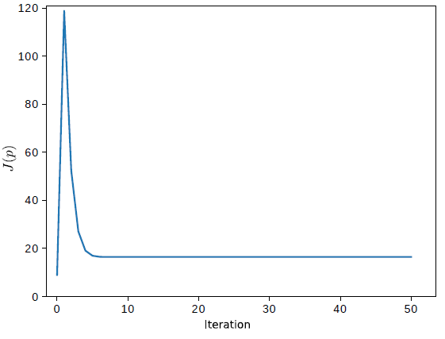
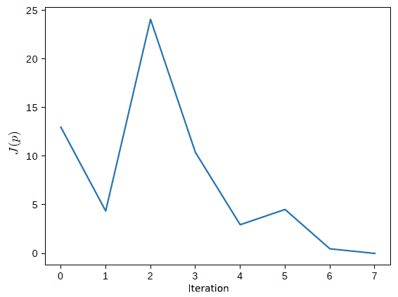
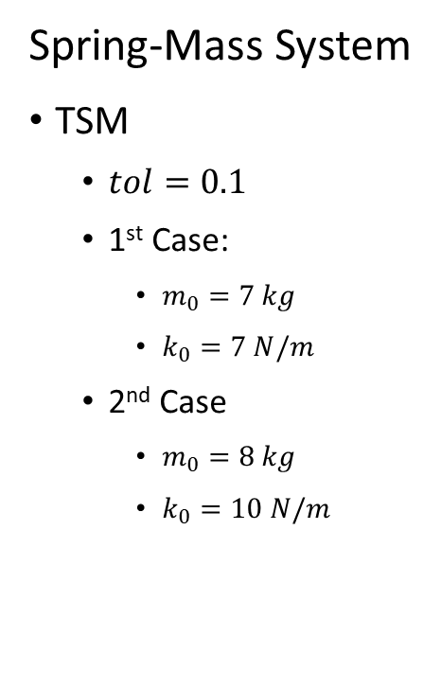
Hybrid Method Application
Spring-Mass System
TSM
$tol=0.1$
1st Case:
$m_{0}=7 kg$
$k_{0}=7 N/m$
2nd Case
$m_{0}=8 kg$
$k_{0}=10 N/m$

Slide 48
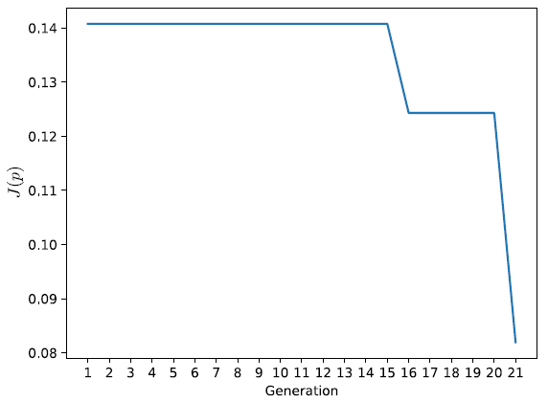
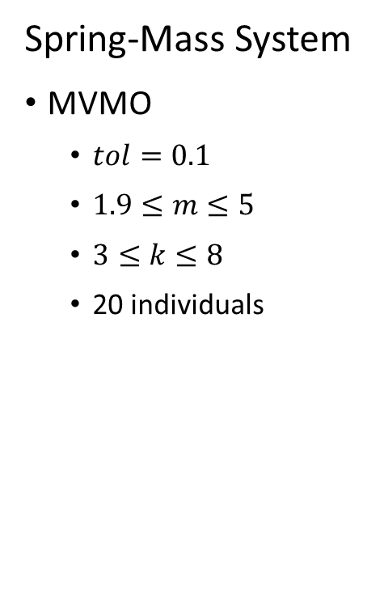
Hybrid Method Application
Spring-Mass System
MVMO
$tol=0.1$
$1.9≤m≤5$
$3≤k≤8$
20 individuals

Slide 49
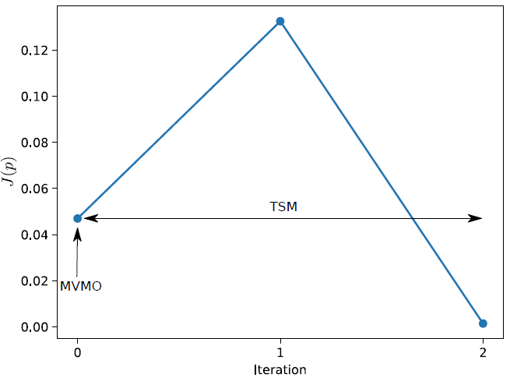
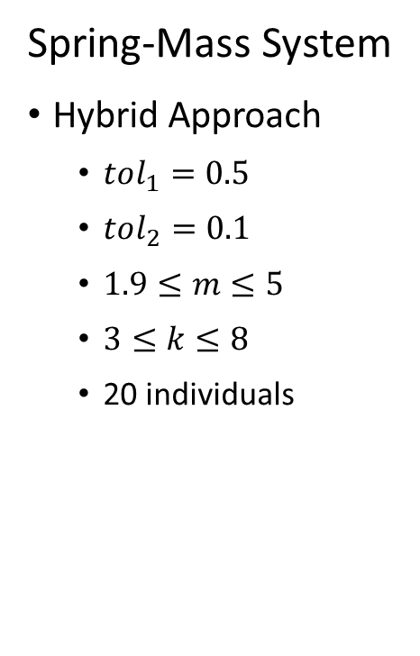
Hybrid Method Application
Spring-Mass System
Hybrid Approach
$tol_{1}=0.5$
$tol_{2}=0.1$
$1.9≤m≤5$
$3≤k≤8$
20 individuals

Slide 50
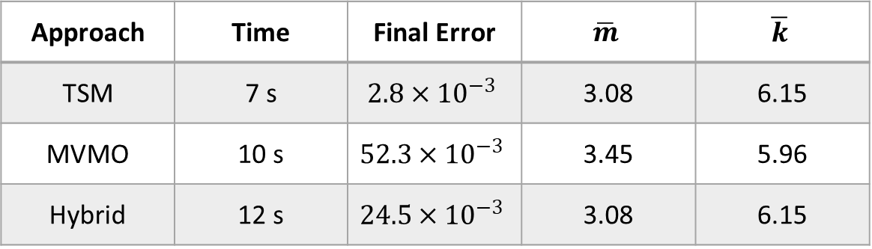
Hybrid Method Application
Approach | Time | Final Error | $$\overline{m}$$ | $$\overline{k}$$
TSM | 7 s | $$2.8×{10}^{−3}$$ | 3.08 | 6.15
MVMO | 10 s | $$52.3×{10}^{−3}$$ | 3.45 | 5.96
Hybrid | 12 s | $$24.5×{10}^{−3}$$ | 3.08 | 6.15

Slide 51
Software Developed

Slide 52
Software
identPy:
Framework for parameter estimation
identPy_GUI:
Graphical User Interface for framework
Python
Non-specific

Slide 53
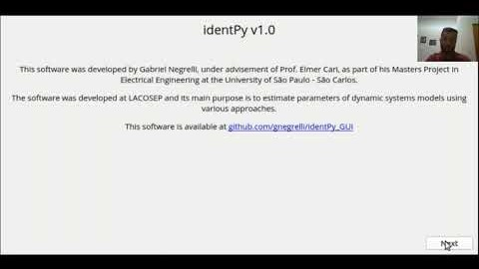
Software

Slide 54
Results

Slide 55
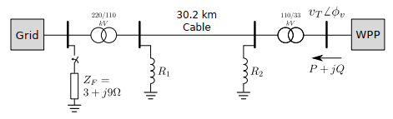
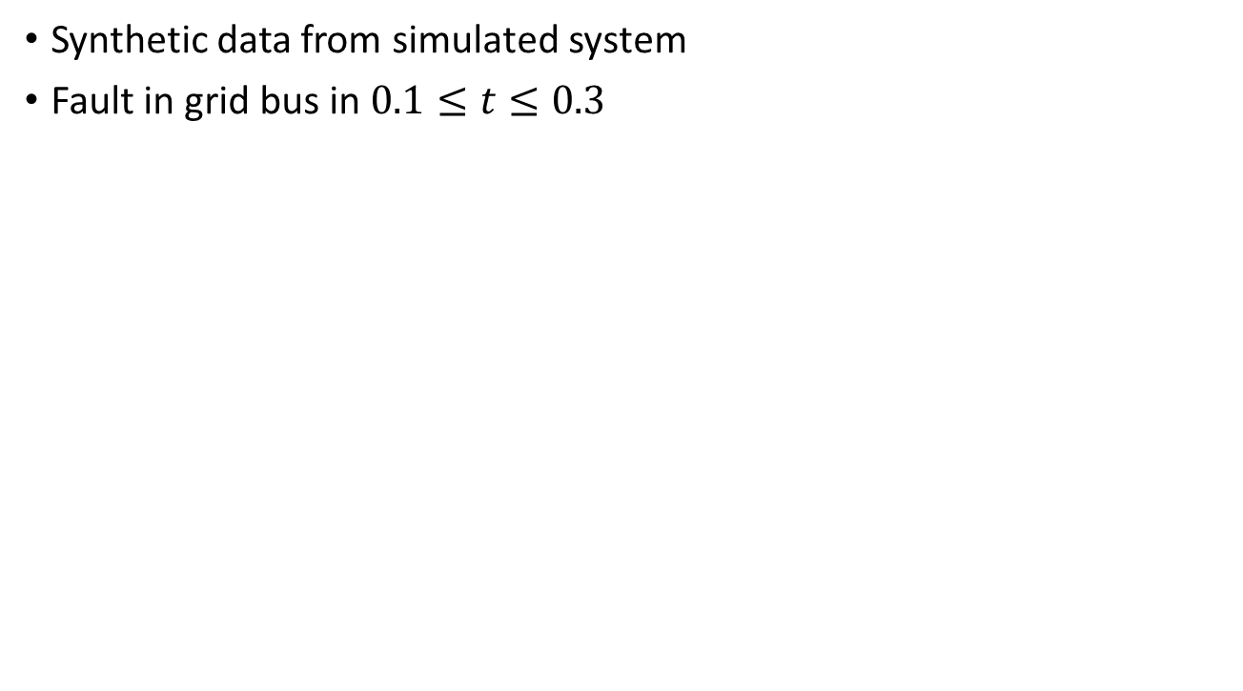
Results
Synthetic data from simulated system
Fault in grid bus in $0.1≤t≤0.3$

Slide 56
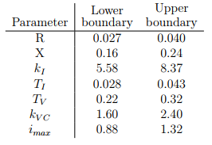
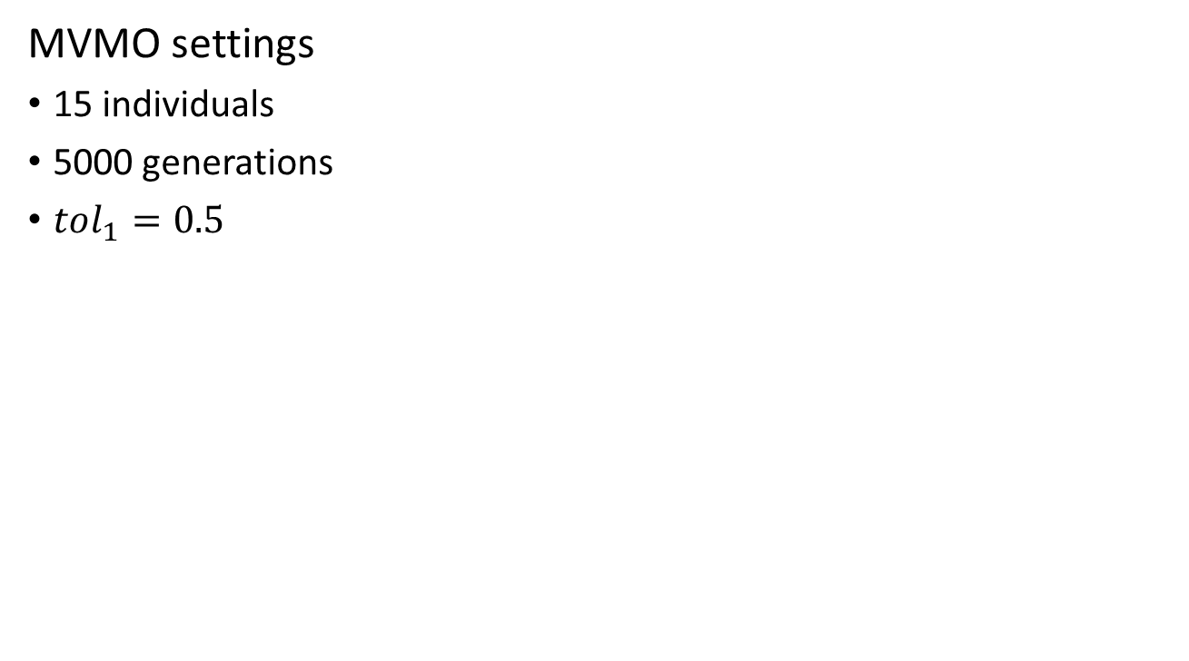
Results
MVMO settings
15 individuals
5000 generations
$tol_{1}=0.5$

Slide 57
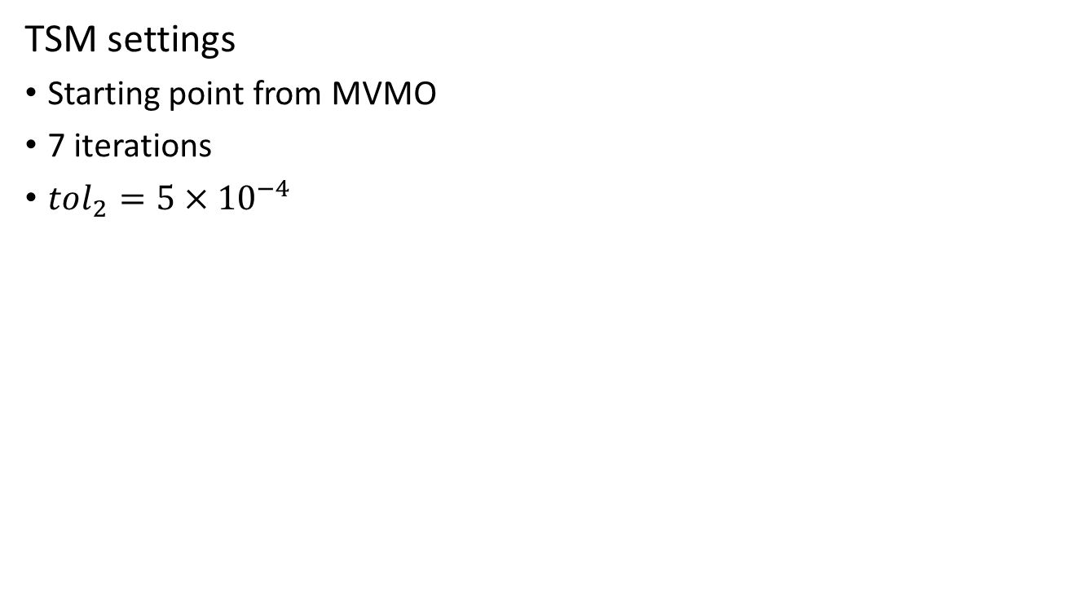
Results
TSM settings
Starting point from MVMO
7 iterations
$tol_{2}=5×{10}^{−4}$

Slide 58
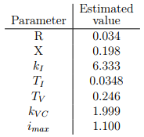
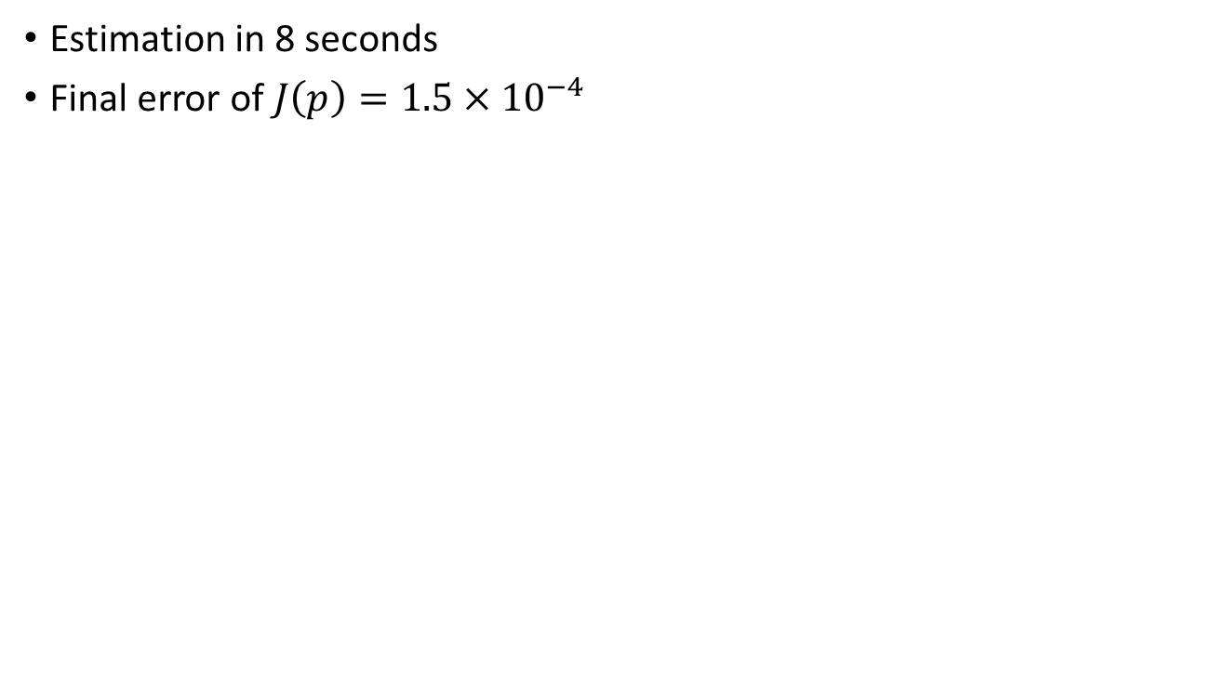
Results
Estimation in 8 seconds
Final error of $J\left(p\right)=1.5×{10}^{−4}$

Slide 59
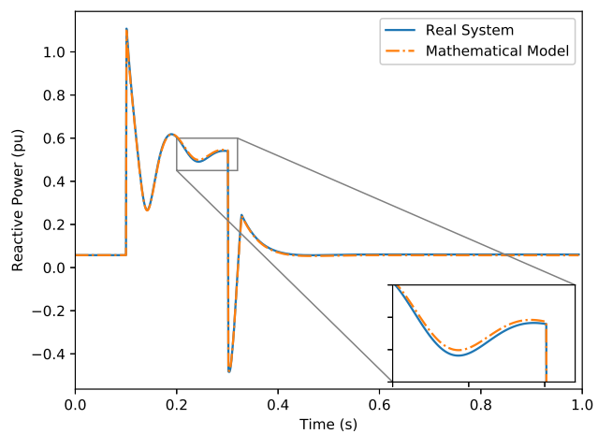
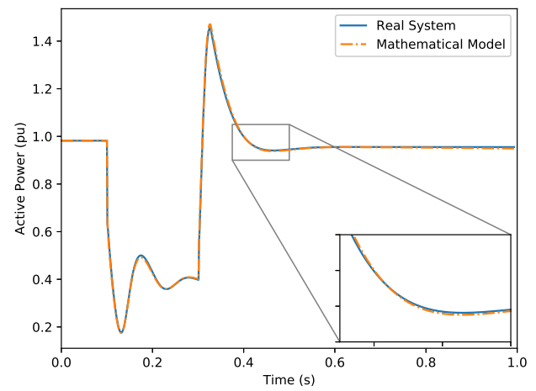
Results

Slide 60
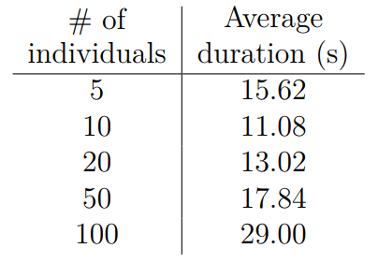

Results
Effects of population size on MVMO
5 population sizes evaluated
35 estimations for each population
$tol=0.5$

Slide 61
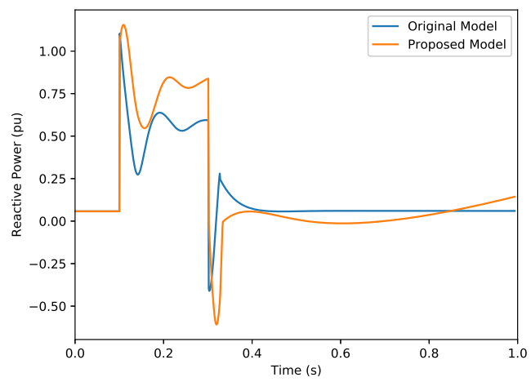
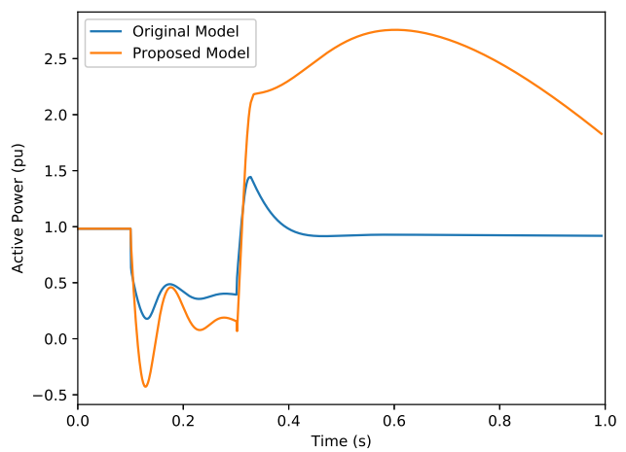
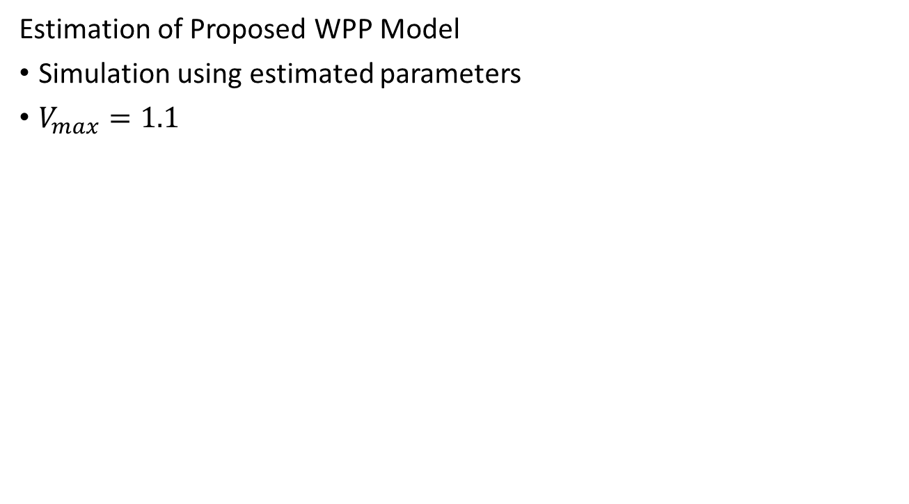
Results
Estimation of Proposed WPP Model
Simulation using estimated parameters
$V_{max}=1.1$

Slide 62
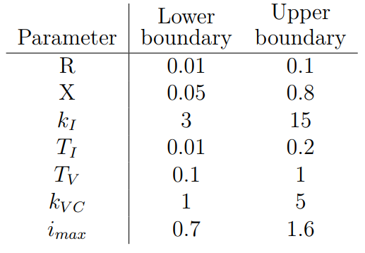
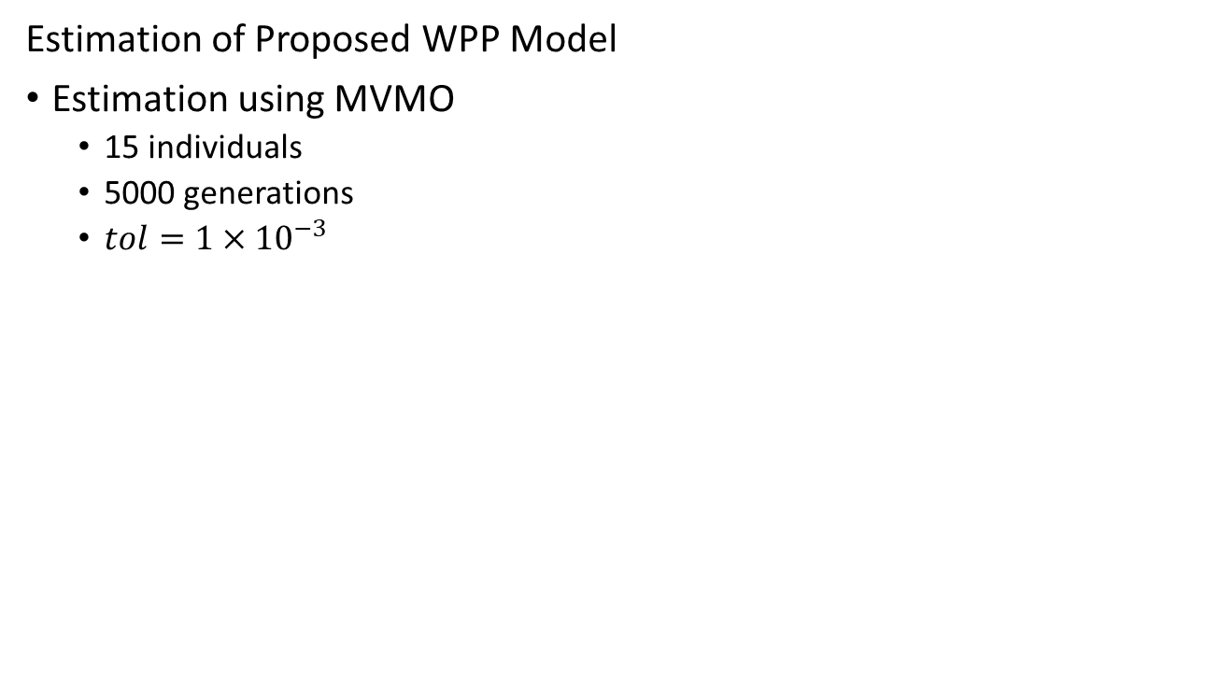
Results
Estimation of Proposed WPP Model
Estimation using MVMO
15 individuals
5000 generations
$tol=1×{10}^{−3}$

Slide 63
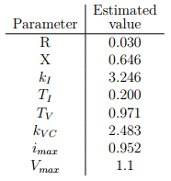
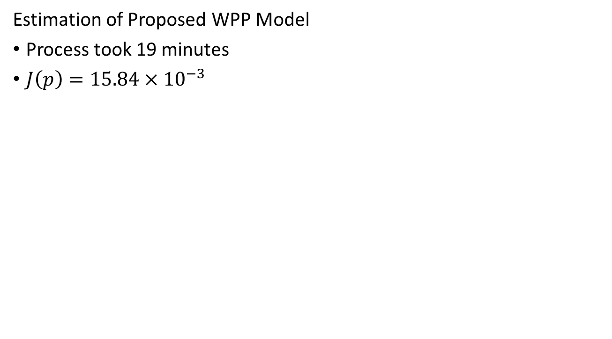
Results
Estimation of Proposed WPP Model
Process took 19 minutes
$J\left(p\right)=15.84×{10}^{−3}$

Slide 64
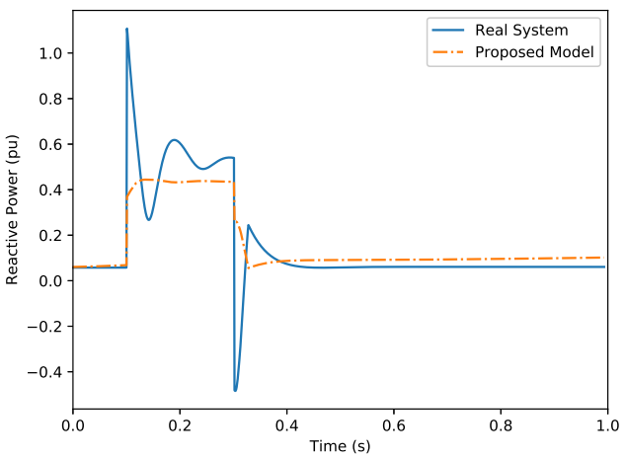
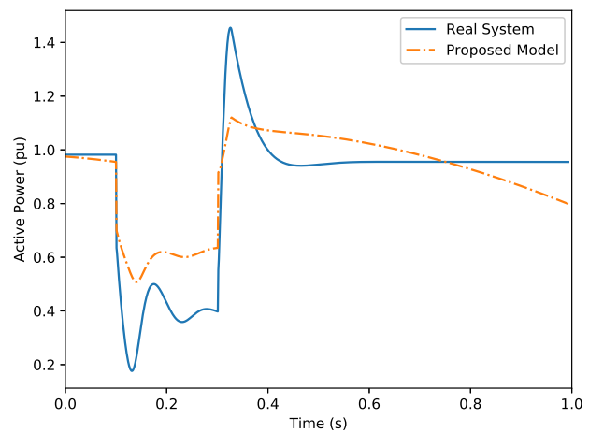
Results

Slide 65
Conclusion

Slide 66
Conclusion
Framework and Software available at GitHub
Users can download, test and contribute with project
Application of software into WPP model problem
Estimation using a hybrid approach (MVMO + TSM)
Proposal of WPP model
Avoid necessity of PMUs in the grid

Slide 67
Ongoing Research

Slide 68
Ongoing Research
Proposed WPP model
Assessment on model behavior
Hybrid Method
Implementation of other estimation methods

Slide 69
Publications

Slide 70
Publications
CBA 2020
Parameter Estimation of Wind Power Plant Equivalent Model through a Hybrid Approach
DINCON 2019
Hybrid Parameter Estimation Method for a Load Model Disturbed by OLTC
IEEE CCECE 2019
Load Model Identification Through a Hybrid Approach

Slide 71
Thank you!
Gabriel José Negrelli Gomes
gabriel.jose.gomes@usp.br

Slide 72
Development of Software for Parameter Estimation and its Application on Wind Power Plant Equivalent Model
Gabriel José Negrelli Gomes
Advisor: Prof. Dr. Elmer Pablo Tito Cari
São Carlos School of Engineering - EESC
University of São Paulo - USP

Slide 73
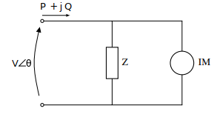
Hybrid Estimation – Load Model
Linearized Z-IM Load Model
Impedance
Third-Order Induction Motor

Slide 74
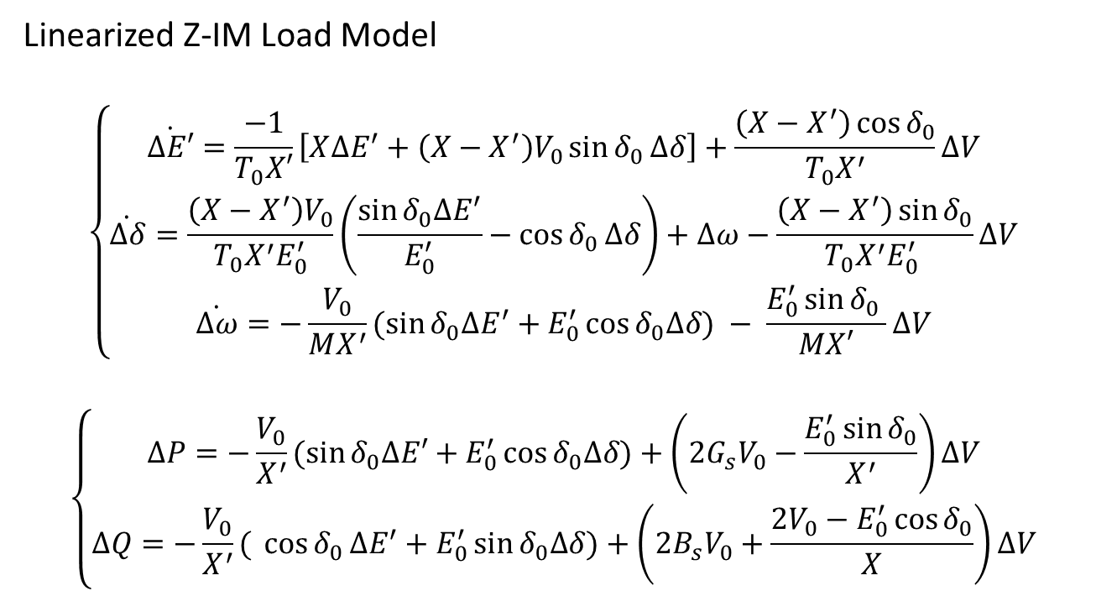
Hybrid Estimation – Load Model
Linearized Z-IM Load Model
$$\left\{\begin{aligned}\dot{∆E′}=\frac{−1}{T_{0}X′}\left[X∆E^{′}+\left(X−X^{′}\right)V_{0}\sin{δ_{0}}∆δ\right]+\frac{\left(X−X^{′}\right)\cos{δ_{0}}}{T_{0}X^{′}}∆V \\ \dot{∆δ}=\frac{\left(X−X^{′}\right)V_{0}}{T_{0}X^{′}E_{0}^{′}}\left(\frac{\sin{δ_{0}∆E^{′}}}{E_{0}^{′}}−\cos{δ_{0}}∆δ\right)+∆ω−\frac{\left(X−X^{′}\right)\sin{δ_{0}}}{T_{0}X^{′}E_{0}^{′} }∆V \\ \dot{∆ω}=−\frac{V_{0}}{MX^{′}}(\sin{δ_{0}∆E^{′}}+E_{0}^{′}\cos{δ_{0}∆δ) − \frac{E_{0}^{′}\sin{δ_{0} }}{MX′}∆V}\end{aligned}\right.$$
$$\left\{\begin{aligned}∆P=−\frac{V_{0}}{X^{′}}(\sin{δ_{0}∆E′+E_{0}^{′}\cos{δ_{0}∆δ)+\left(2G_{s}V_{0}−\frac{E_{0}^{′}\sin{δ_{0}}}{X^{′}}\right)∆V}} \\ ∆Q=−\frac{V_{0}}{X^{′}}({\cos{δ_{0}}∆E^{′}+E_{0}^{′}\sin{δ_{0}∆δ)+\left(2B_{s}V_{0}+\frac{2V_{0}−E_{0}^{′}\cos{δ_{0}}}{X}\right)∆V}}\end{aligned}\right.$$

Slide 75

Hybrid Estimation – Load Model
Linearized Z-IM Load Model
$$x={\left[∆E′,∆δ,∆ω \right]}^{T}$$
$$y={\left[∆P,∆Q\right]}^{T}$$
$$u=∆V$$
$$p={\left[X, X^{′},T_{0},M,G_{s},B_{s}{,E}_{0}^{′},δ_{0}\right]}^{T}$$

Slide 76


Hybrid Estimation – Load Model
Linearized Z-IM Load Model
$tol=0.5×{10}^{−4}$
5 individuals

Slide 77

MVMO Process

Slide 78

MVMO Process

Slide 79

Software

Slide 80

Software

Slide 81

Software

Slide 82

Software

Slide 83

Software

